Slide 1
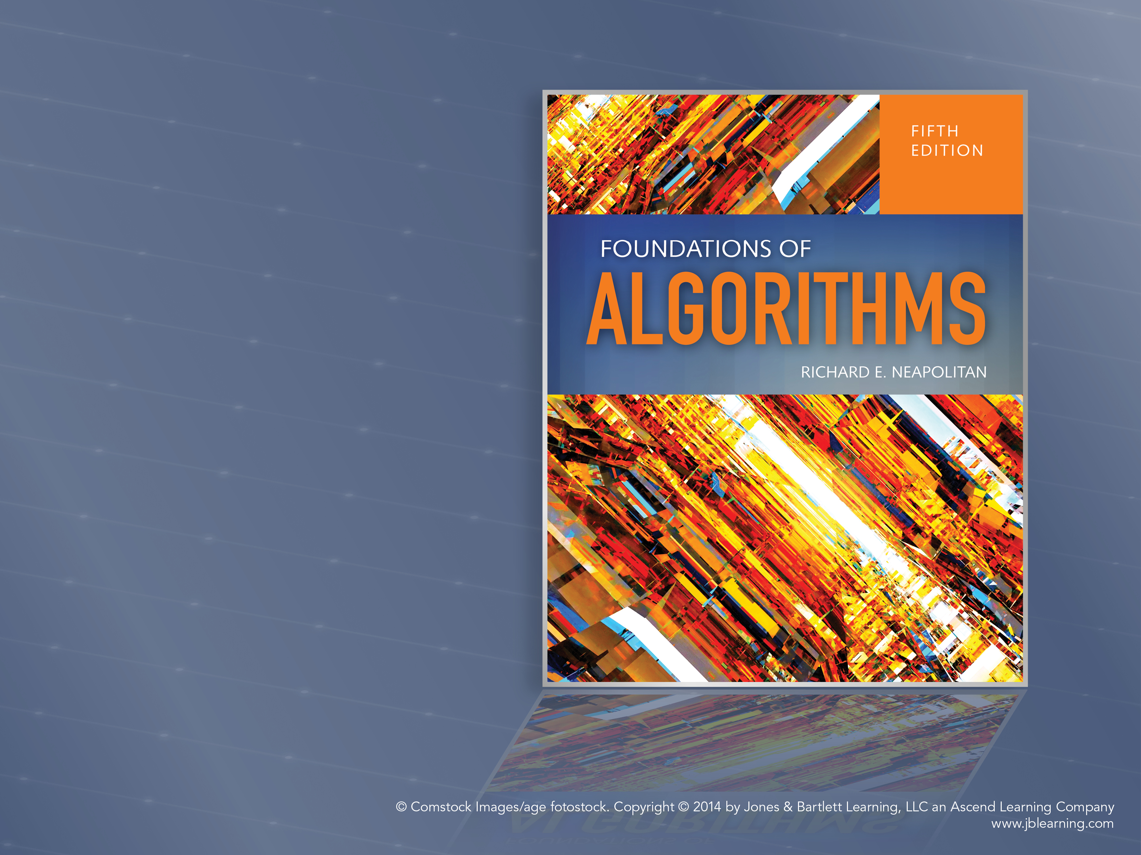
Algorithms: Efficiency, Analysis, and Order
Chapter 1

Slide 2
Objectives
Analyze techniques for solving problems
Define an algorithm
Define growth rate of an algorithm as a function of input size
Define Worst case, average case, and best case complexity analysis of algorithms
Classify functions based on growth rate
Define growth rates: Big O, Theta, and Omega

Slide 3
Methodology
Approach to solving a problem
Independent of Programming Language
Independent of Style
Sequential Search versus Binary Search
Which technique results in the most efficient solution?

Slide 4
Problem?
A question to which an answer is sought
Parameters
Input to the problem
Instance: a specific assignment of values to the input parameters
Algorithm:
Step-by-step procedure
Solves the Problem

Slide 5
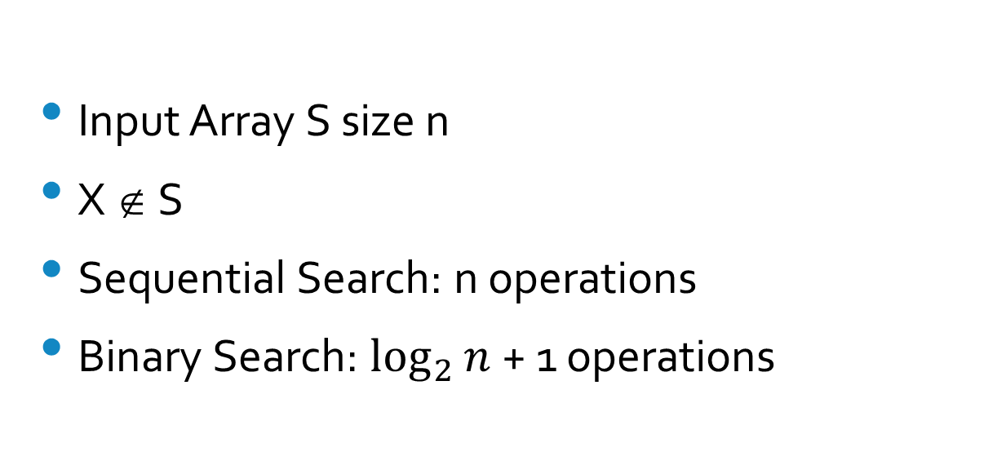
Sequential Search vs Binary Search – Worst Case
Input Array S size n
X ∉ S
Sequential Search: n operations
Binary Search: $\log_{2}{n}$ + 1 operations

Slide 6
Fibonacci: Iterative vs Recursive
Fib₀ = 0
Fib₁ = 1
Fib_{n} = Fib_{n-1 +} Fib_{n-2}
Calculate the nth Fibonacci Term:
Recursive calculates 2^{n/2} terms
Iterative calculates n+1 terms

Slide 7
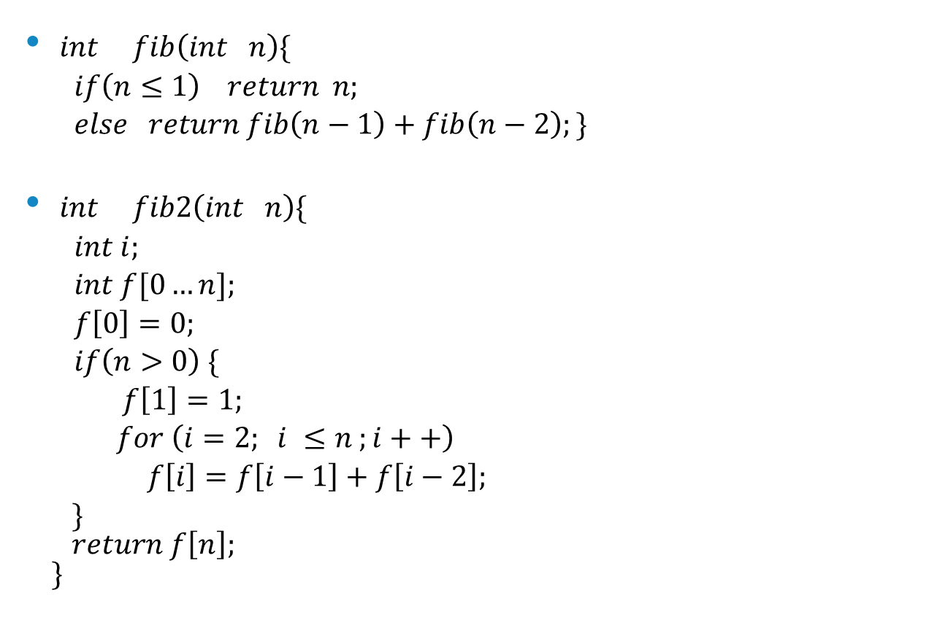
Algorithms for computing nth Fibonacci term
$int fib\left(int n\right)\{$
$if\left(n≤1\right) return n;$
$else return fib\left(n−1\right)+fib\left(n−2\right);\}$
$int fib2\left(int n\right)\{$
$int i;$
$int f[0…n];$
$f\left[0\right]=0;$
$if\left(n>0\right) \{$
$f\left[1\right]=1;$
$for \left(i=2; i ≤n ;i++\right)$
$f\left[i\right]=f\left[i−1\right]+f\left[i−2\right];$
$\}$
$return f\left[n\right];$
$\}$

Slide 8
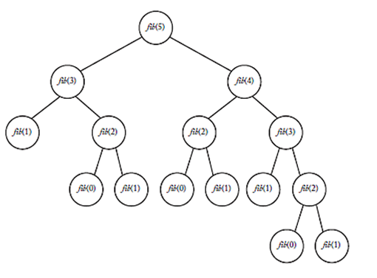
Recursion Tree for the 5th Fibonacci Term

Slide 9
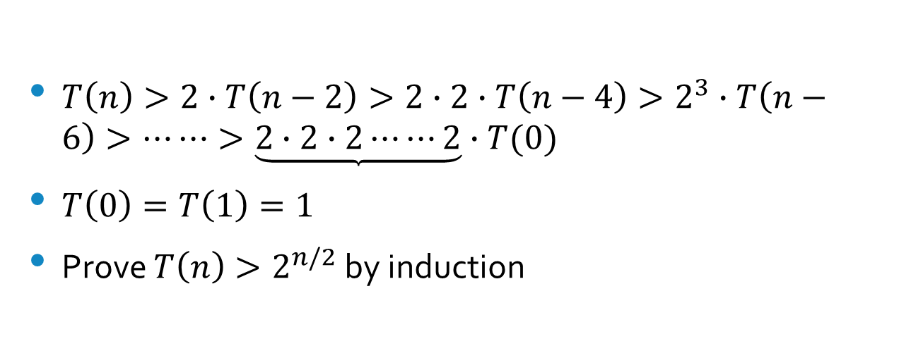
Time Complexity Analysis for Fibonacci Recursion Algorithm
$T\left(n\right)>2∙T\left(n−2\right)>2∙2∙T\left(n−4\right)>2^{3}∙T\left(n−6\right)>⋯⋯>\underbrace{2∙2∙2⋯⋯2}∙T(0)$
$T\left(0\right)=T\left(1\right)=1$
Prove $T\left(n\right)>2^{n/2}$ by induction

Slide 10
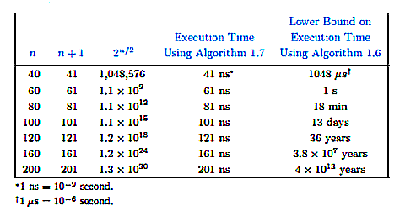
Comparison of Recursive and Iterative Solutions

Slide 11
Complexity Analysis
Define Basic Operation
Count the number of times the basic operation executes for each value of the input size
Maybe dependent on input size (sequential search)
Every-case time complexity analysis

Slide 12
Complexity Analysis – Large n
Worst Case
Every Case
Average Case
Best Case

Slide 13
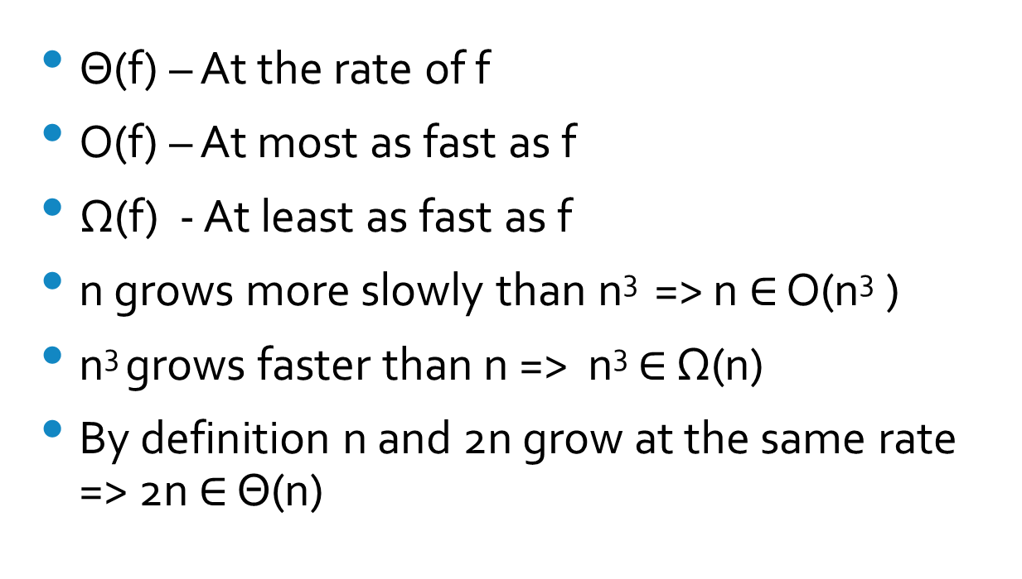
Order – Classes of Functions – Growth Rate
Θ(f) – At the rate of f
O(f) – At most as fast as f
Ω(f) - At least as fast as f
n grows more slowly than n³ => n $∈$ O(n³ )
n³ grows faster than n => n³ $∈$ Ω(n)
By definition n and 2n grow at the same rate => 2n $∈$ Θ(n)

Slide 14
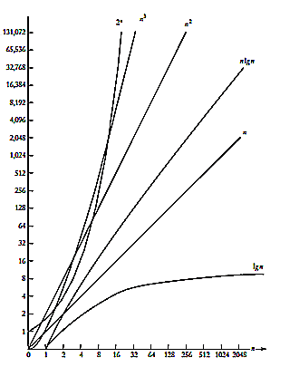
Growth Rates of Common Complexity Functions

Slide 15
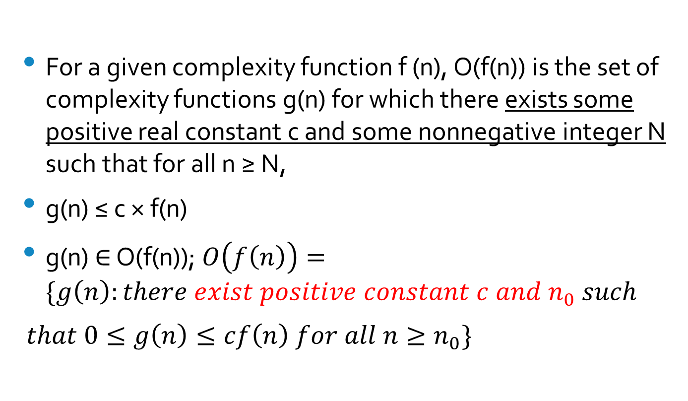
Big O
For a given complexity function f (n), O(f(n)) is the set of complexity functions g(n) for which there exists some positive real constant c and some nonnegative integer N such that for all n ≥ N,
g(n) ≤ c × f(n)
g(n) $∈$ O(f(n)); $O\left(f\left(n\right)\right)=\{g\left(n\right):there exist positive constant c and n_{0} such$
$that 0≤g\left(n\right)≤cf\left(n\right) for all n≥n_{0}\}$

Slide 16
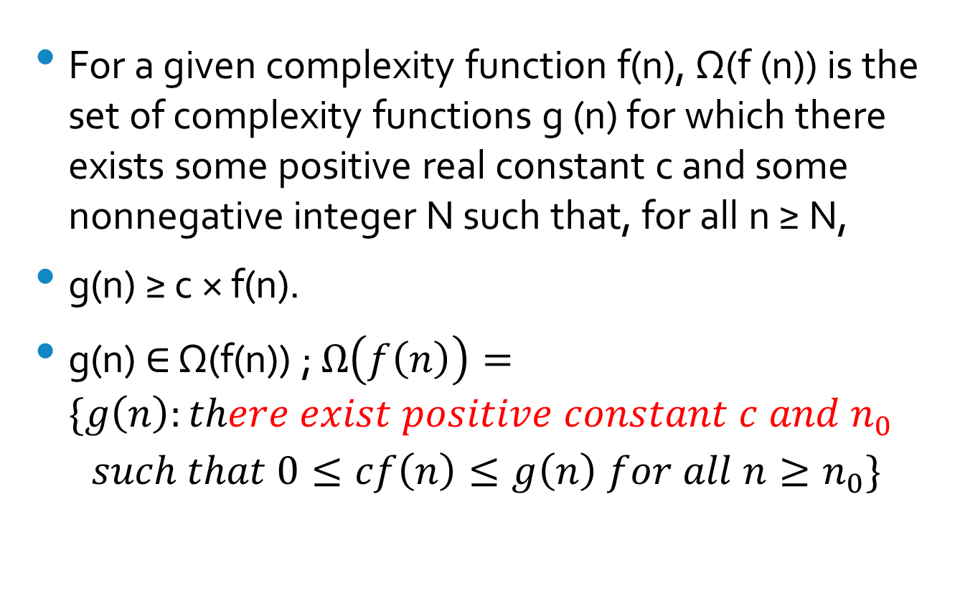
Omega
For a given complexity function f(n), Ω(f (n)) is the set of complexity functions g (n) for which there exists some positive real constant c and some nonnegative integer N such that, for all n ≥ N,
g(n) ≥ c × f(n).
g(n) $∈$ Ω(f(n)) ; $Ω\left(f\left(n\right)\right)=\{g\left(n\right):there exist positive constant c and n_{0}$
$$such that 0≤cf\left(n\right)≤g\left(n\right) for all n≥n_{0}\}$$

Slide 17
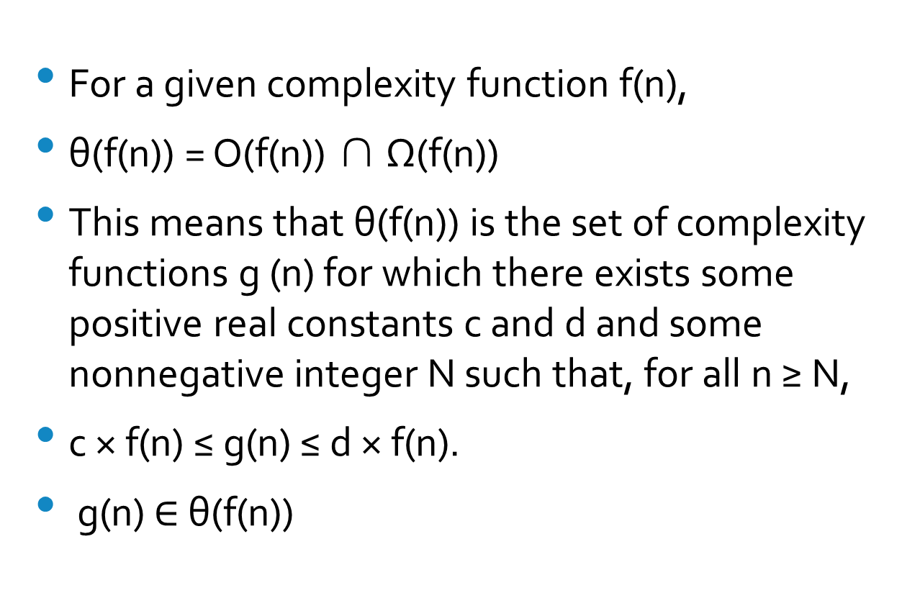
Theta
For a given complexity function f(n),
θ(f(n)) = O(f(n)) ∩ Ω(f(n))
This means that θ(f(n)) is the set of complexity functions g (n) for which there exists some positive real constants c and d and some nonnegative integer N such that, for all n ≥ N,
c × f(n) ≤ g(n) ≤ d × f(n).
g(n) $∈$ θ(f(n))

Slide 18
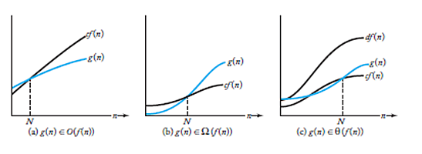
Big O, Omega, Theta

Slide 19
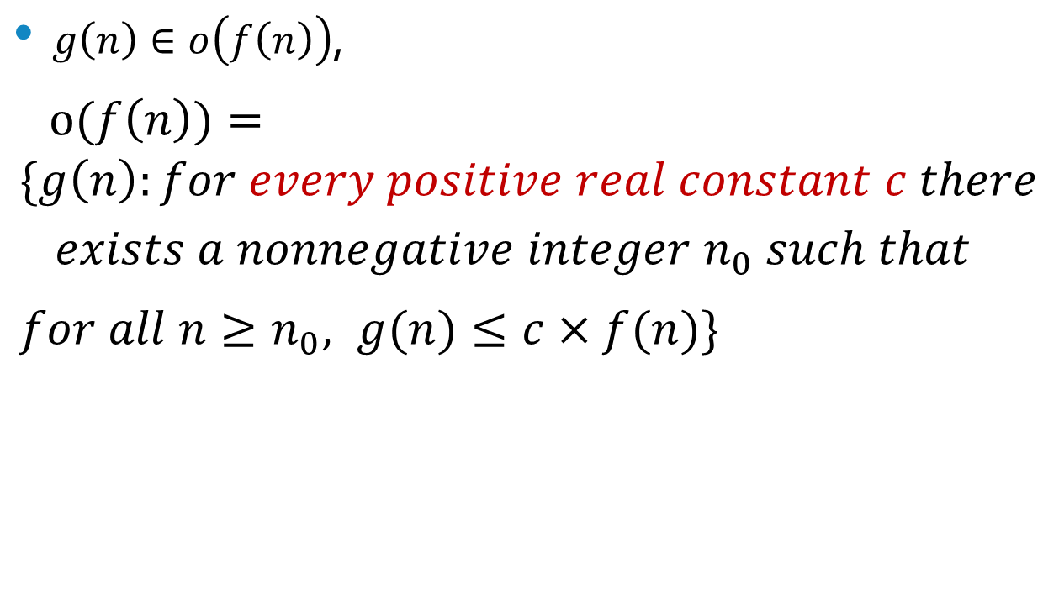
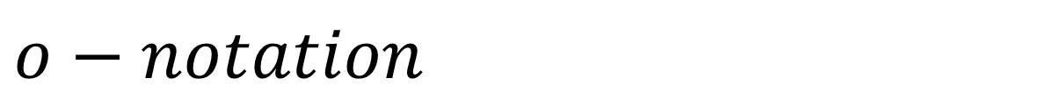
$$o−notation$$
$g\left(n\right)∈o\left(f\left(n\right)\right)$,
$o(f\left(n\right))=\{g\left(n\right):for every positive real constant c there$
$$exists a nonnegative integer n_{0} such that$$
$for all n≥n_{0}, g(n)≤c×f(n)\}$

Slide 20
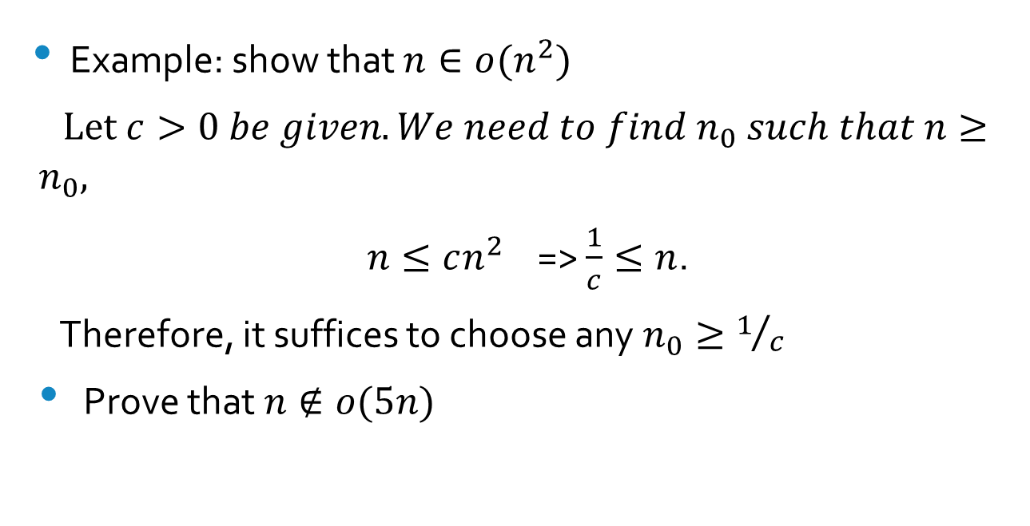
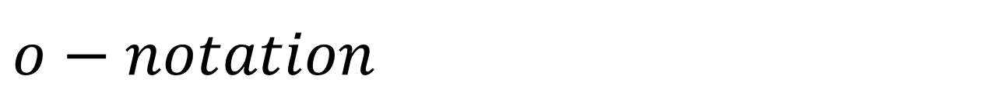
$$o−notation$$
Example: show that $n∈o(n^{2})$
$Let c>0 be given. We need to find n_{0} such that n≥n_{0},$
$n≤cn^{2}$ => $\frac{1}{c}≤n$.
Therefore, it suffices to choose any $n_{0}≥1/c$
Prove that $n∉o(5n)$

Slide 21
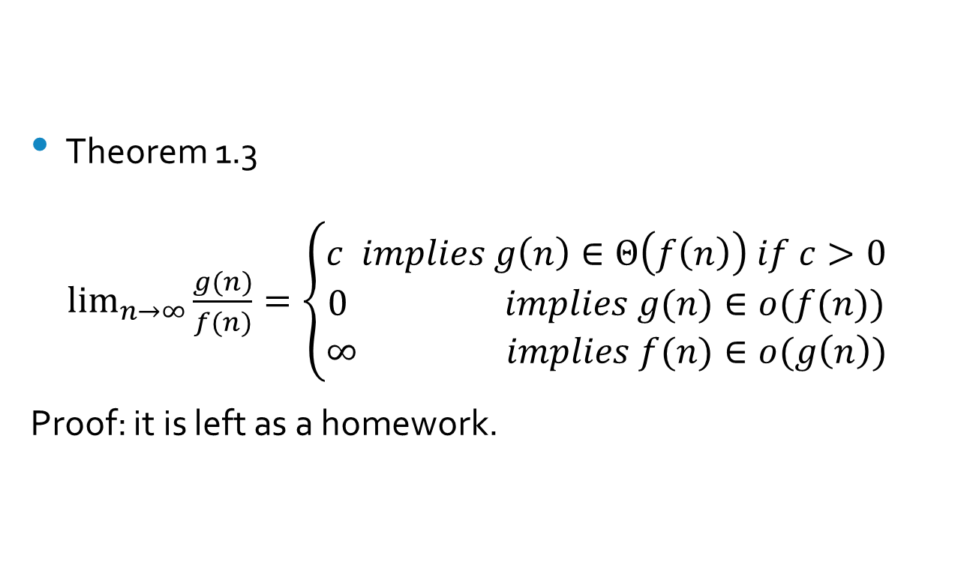
Using a Limit to Determine Order
Theorem 1.3
$\lim_{n→∞}{\frac{g(n)}{f(n)}}=\left\{\begin{aligned}c implies g\left(n\right)∈Θ\left(f\left(n\right)\right) if c>0 \\ 0 implies g(n)∈o(f(n)) \\ ∞ implies f(n)∈o(g\left(n\right))\end{aligned}\right.$
Proof: it is left as a homework.

